Slide 1
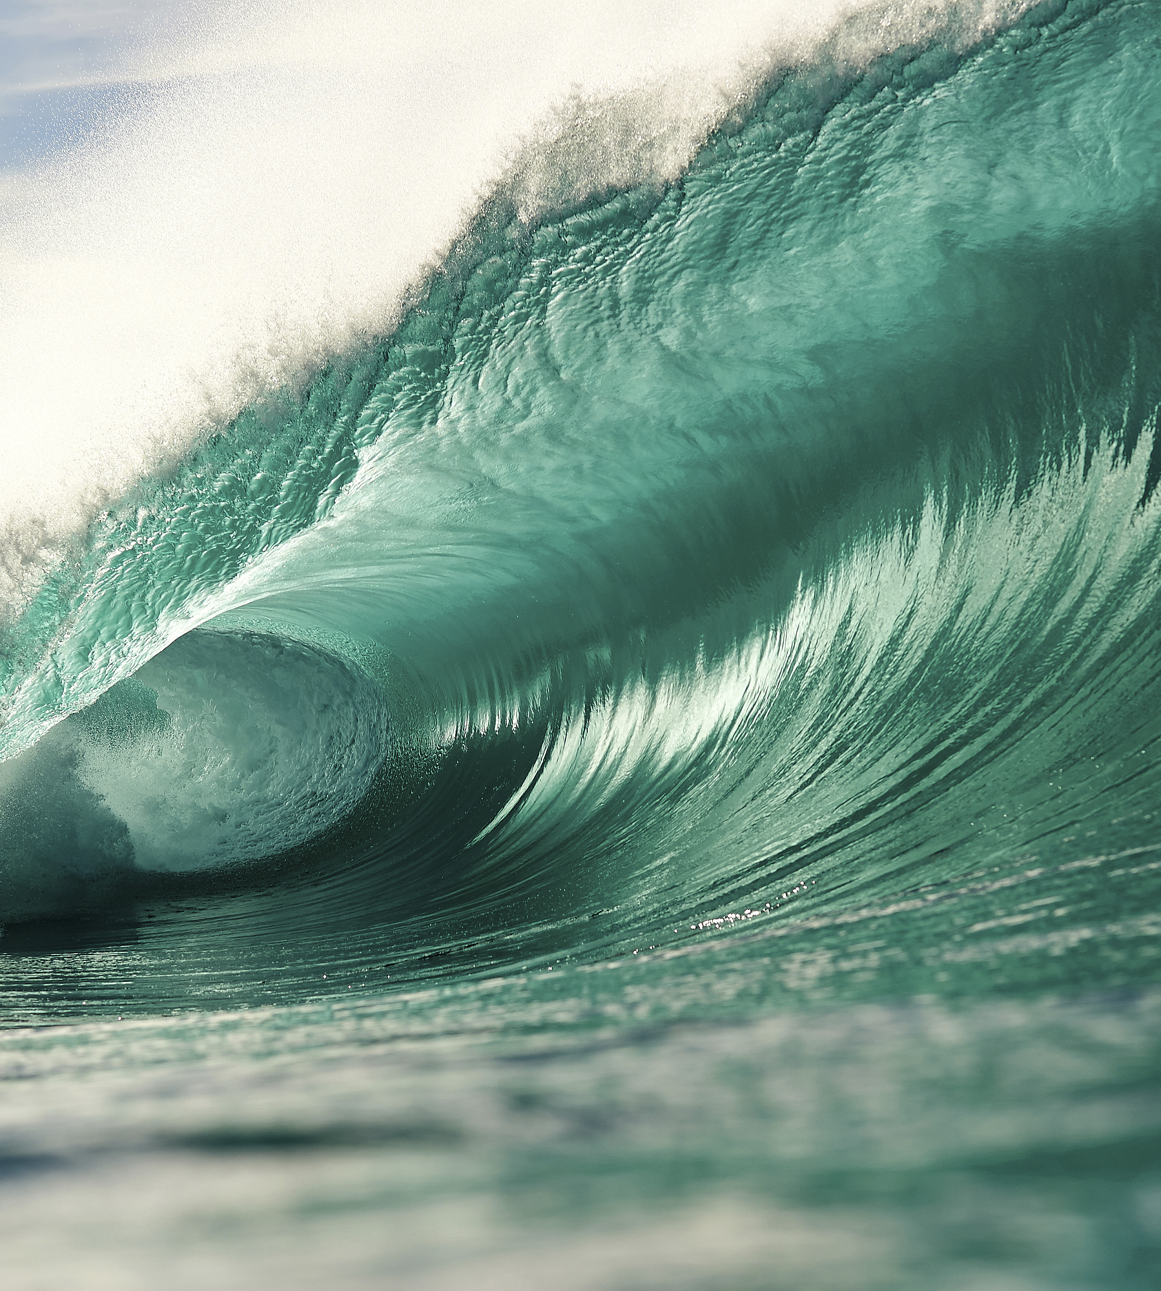
Instructions
The following slides include several graphic elements and layouts that can be used as starting point for your presentation.
Please make sure you have all of the Surfrider brand fonts installed on your computer. If needed , you can Download the fonts here.
If you need a custom graphic created for your presentation, please submit a project request form.
If you have any questions about using this template, please email kkland@surfrider.org

Slide 2
Insert Presentation
Title Here
By: Presenter Name, Title

Slide 5
Add A Section Title Here

Slide 6
Create A Custom Section Title Slide

Slide 7
Add a short and impactful statement
ex: the seas are rising and so are we

Slide 8
2-Column Layout With Image
Add a subtitle
Add some body copy or bullet points here.

Slide 9
2-Column Layout
Add a subtitle
Add a subtitle
Add some body copy or bullet points here.
Add some body copy or bullet points here.

Slide 10
Blank Slide With Title

Slide 11
Icons
Initiatives
Programs

Slide 12
Arrows
Use these arrows to call attention to impactful numbers and graphics as demonstrated in the following examples.
Volunteers collected 300,000 lbs of trash. That’s about the weight of an adult blue whale.
Our efforts are paying off. See what we’ve accomplished so far
176
Chapters and
Student Clubs
670
Coastal Victories Since 2006
182K
Volunteer Hours
in 2019

