Slide 1
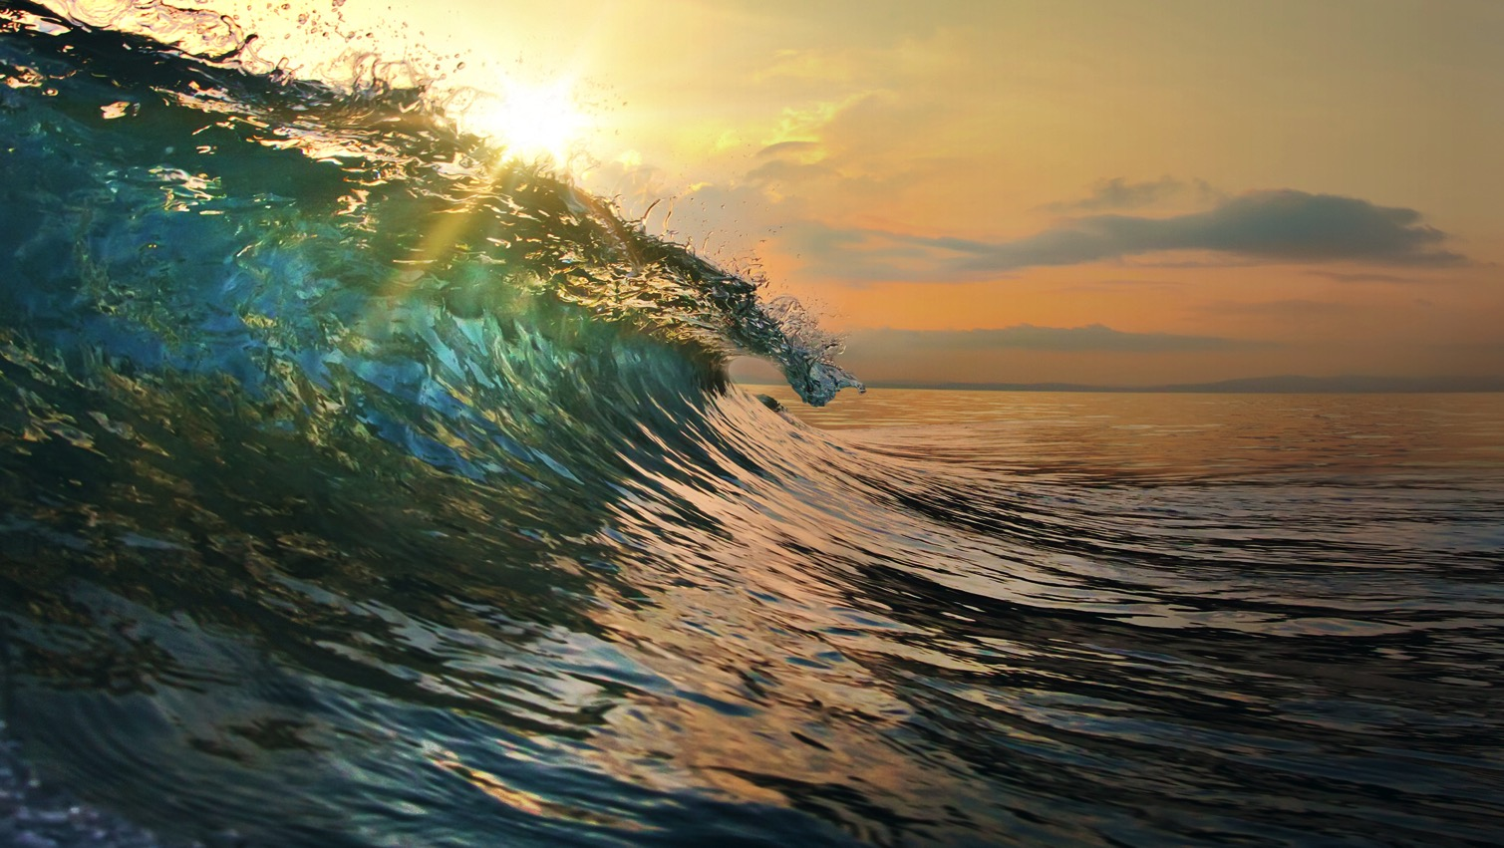

SOCIAL MEDIA 2016-2017

Slide 2
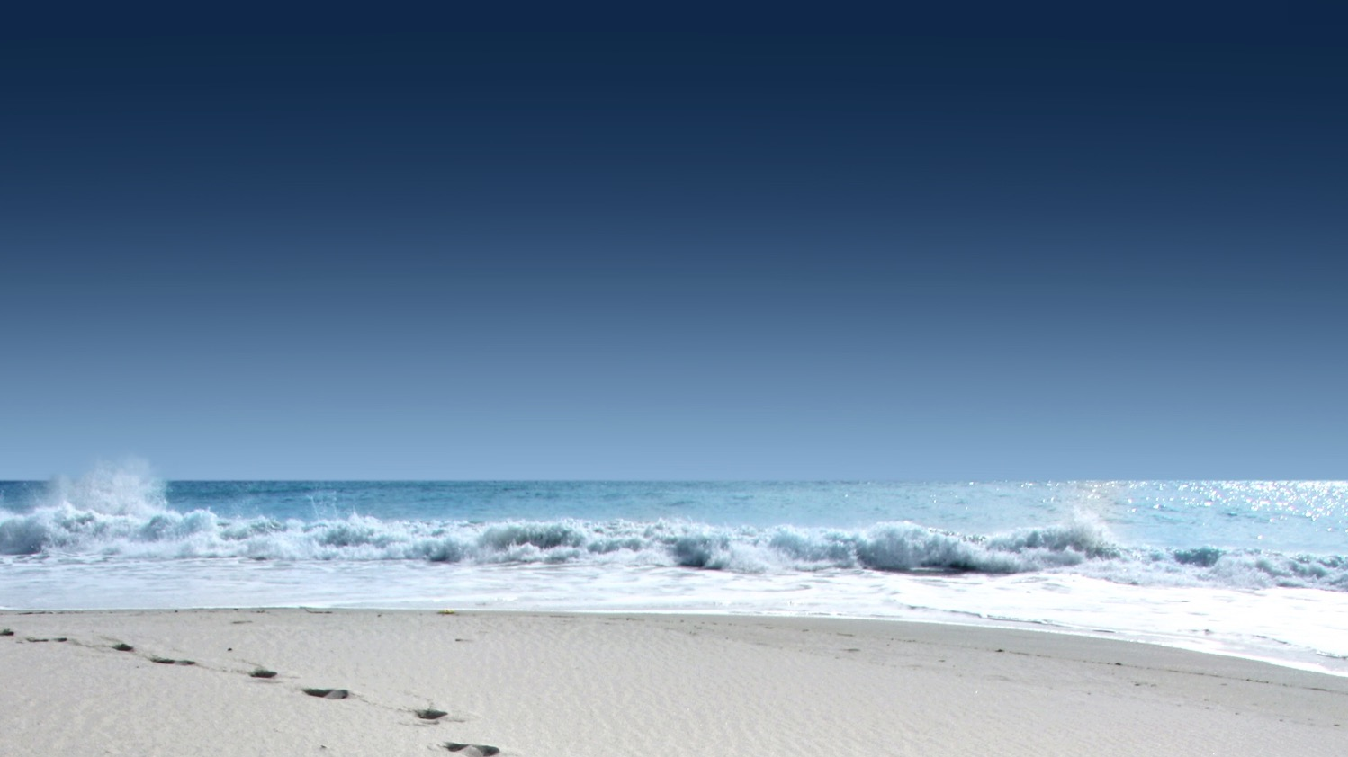
Surfrider Foundation
Social Media 2016
1. Overview of national channels
A. Where are we now?
B. How we built our social strategy
2. Tips for increasing engagement & ROI
3. Social media tools and resources
3. Where are we heading? 2017 and beyond

Slide 3
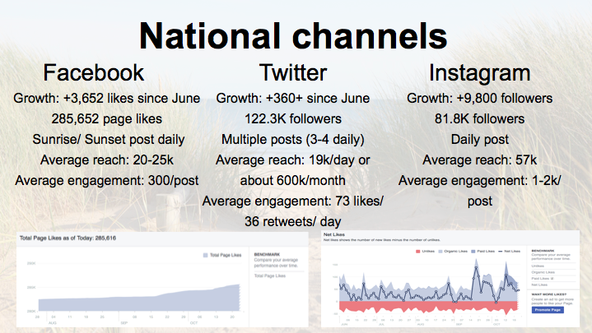

Slide 4
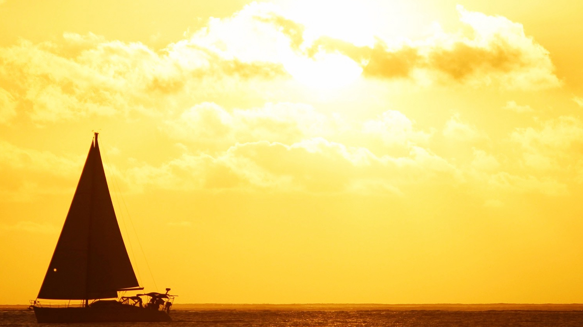
How we built our social strategy
Determined key performance goals
Decided on target audience
Identified channels based on social landscape
Created content strategy
  Define voice
  Create pattern of frequency
  Plan before posting
Analysis of audience behavior (what works)
Track and measure results (no ROI without engagement)

Slide 5
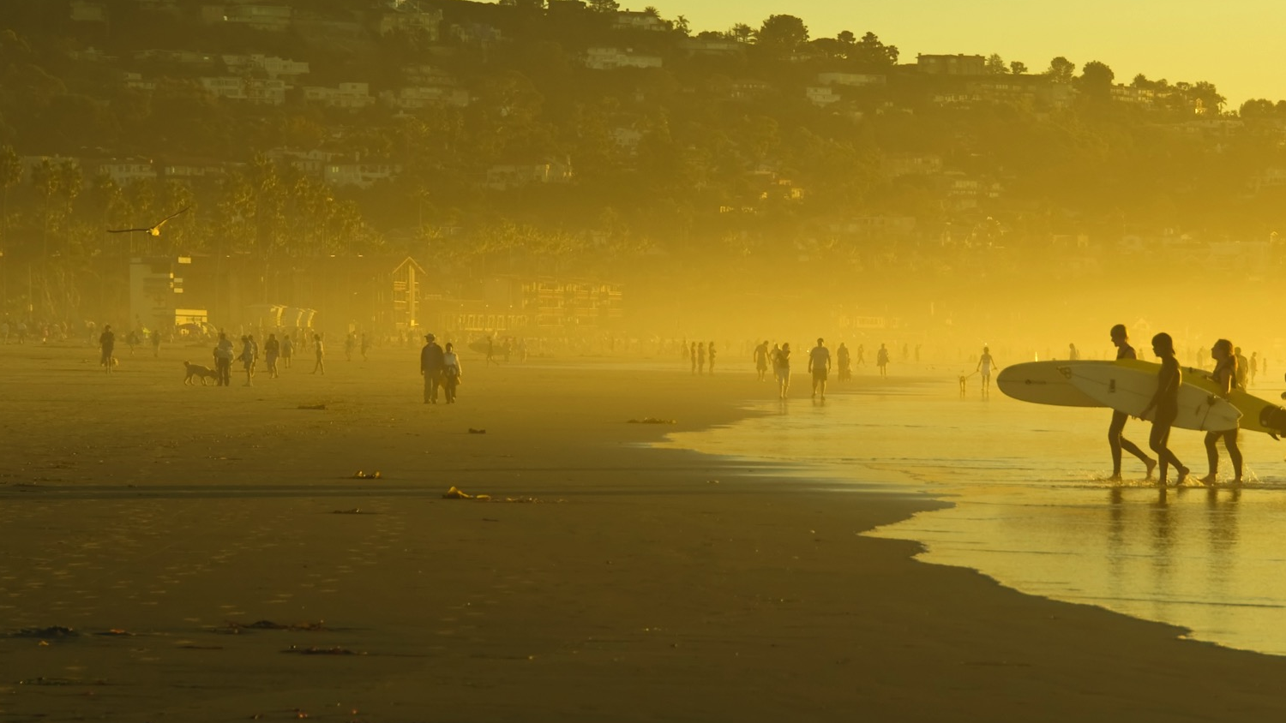
Key Performance Goals:
What do we want to achieve?
Education about cause, mission and vision
Sharing news of organization on broader platform
Increased growth of followers and engagement
Volunteer recruitment
Partner recognition
Ambassador outreach
Increased conversions in donations, memberships,
champions & supporters

Slide 6
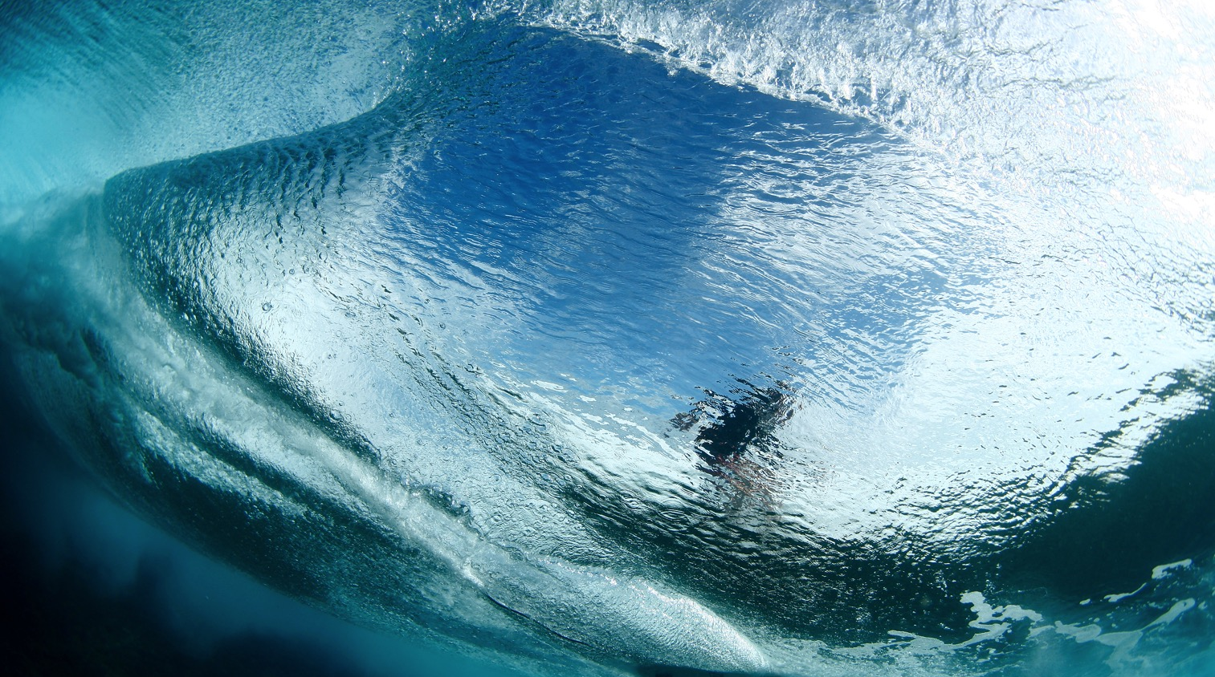
Target audience: who do we want to reach?
Maintain solid foundation of current followers
Grow and diversify audience in terms of:
age, background, location and activity
Connect with influencers, ambassadors and media
To define new audience, identify personas to craft messaging

Slide 7
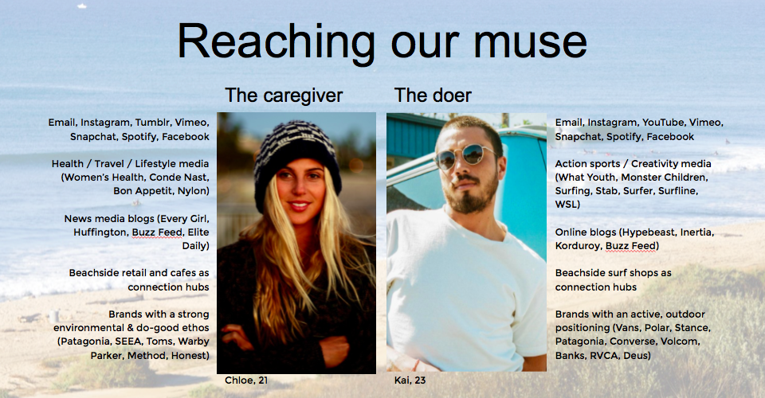

Slide 8
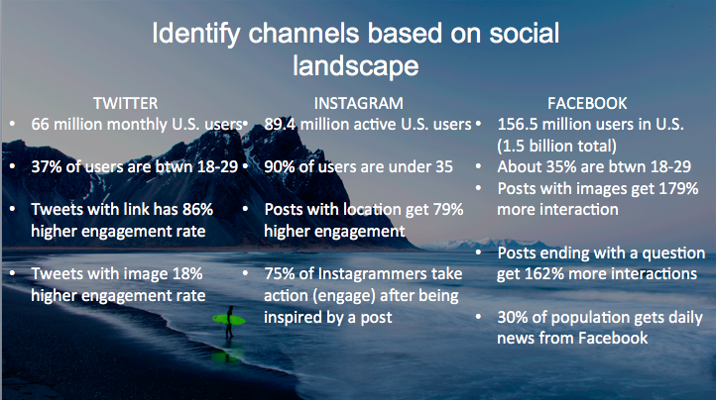

Slide 9
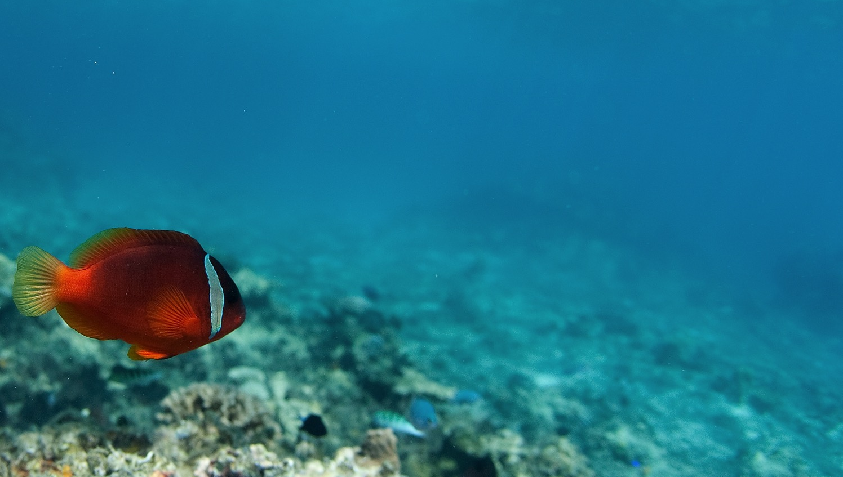
Create content strategy
A. What’s your voice?
Passionate
Involved
Sarcastic/ snarky
Witty
Transformational
Informative
Inspirational
Aspirational
Solution-oriented

Slide 10
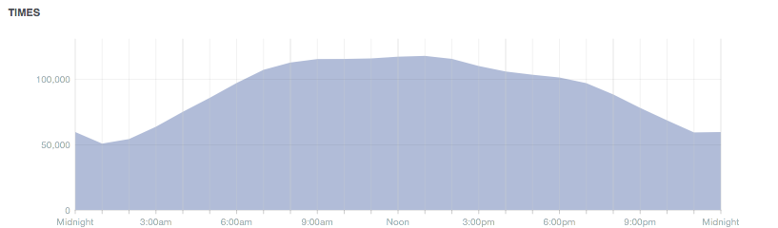
B. Create pattern of frequency
Facebook: Sunrise (around peak time of 8-9:30am) and Sunset (between 5-6:30pm)
Instagram: engagement at all times of day, sometimes later in afternoon to align with Sunset FB post, what’s more important is engaging content (video, images that are visually compelling, unique or have a bit of humor)
Twitter: Multiple throughout the day, generally during work day hours

Slide 11
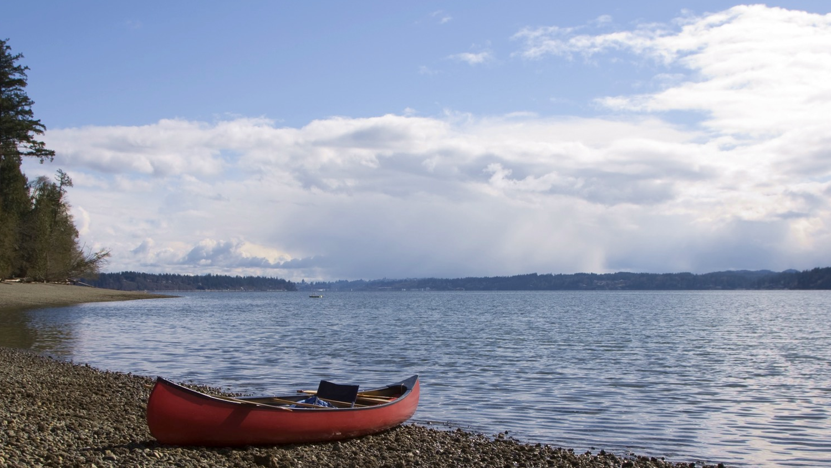
C. Plan before posting
Questions to ask:
Relevance to mission/ vision?
Relevant to our audience (or how do we need to modify messaging so it is relevant)?
Does this tie into performance goals (ie. Sharing news, volunteer recruitment, partner recognition, etc. )
Will post help to move people in a direction of action, motivation, or change?

Slide 12
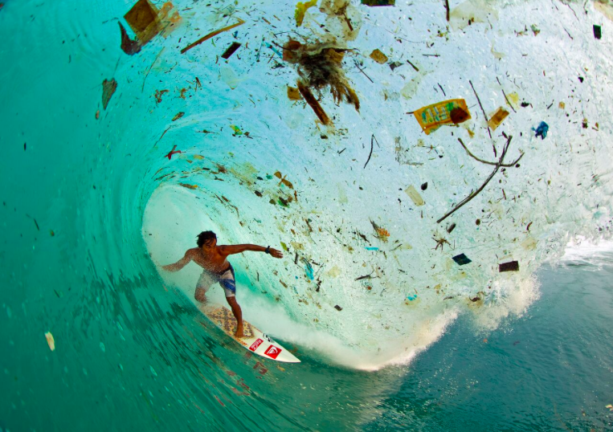

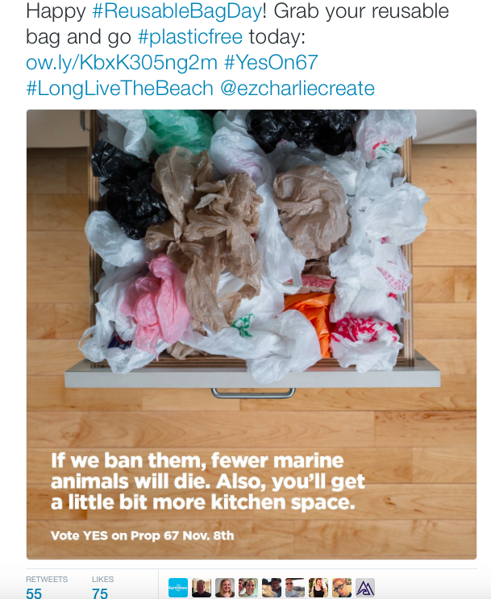
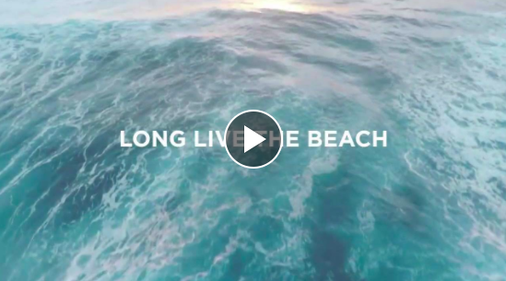
Understand audience behavior: what works? (Shareable, surprising, new perspective, funny or video)

Slide 13

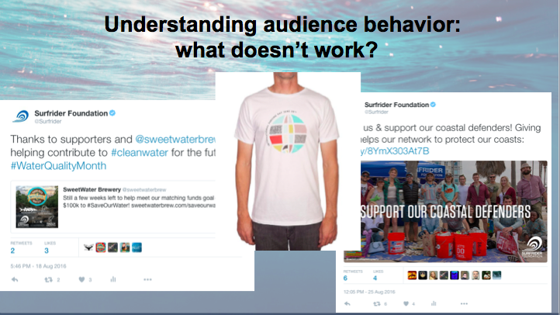
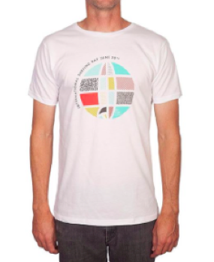
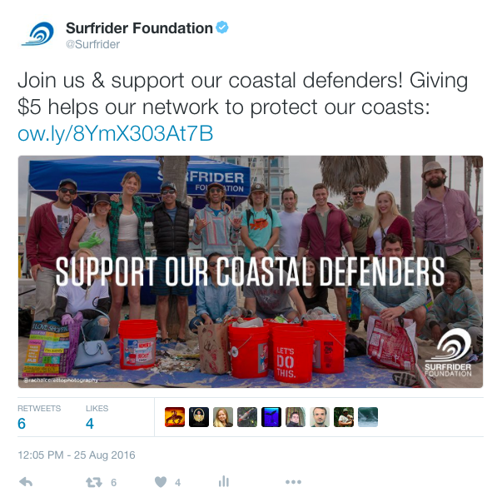
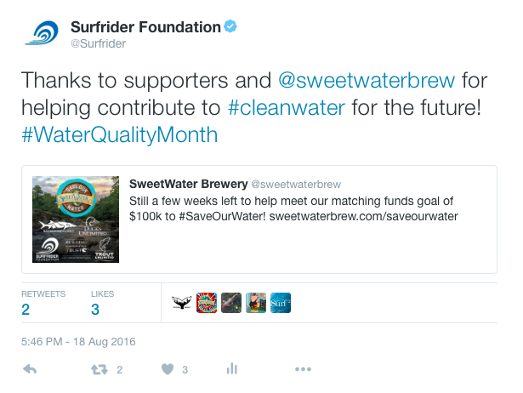
Understanding audience behavior: what doesn’t work?

Slide 14
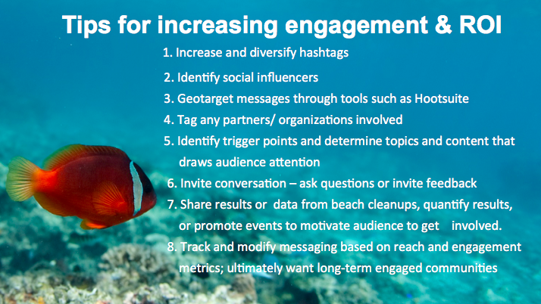
Tips for increasing engagement & ROI
1. Increase and diversify hashtags
2. Identify social influencers
3. Geotarget messages through tools such as Hootsuite
4. Tag any partners/ organizations involved
5. Identify trigger points and determine topics and content that draws audience attention
6. Invite conversation – ask questions or invite feedback
7. Share results or data from beach cleanups, quantify results, or promote events to motivate audience to get involved.
8. Track and modify messaging based on reach and engagement metrics; ultimately want long-term engaged communities

Slide 15
Social tools
  1. Hootsuite: free up to three channels
  Track followers, tags and influencers
  Conduct analysis of social posts and trending topics
  Key metrics: reach, shares and total engagement
  Geotarget
  2. Social media toolkits:
  Developed for days of activation, campaigns and partnerships
  We are generating these for each month, which will be stored on the brand portal in addition to staff and chapter net.
  We will also maintain resources and tips for social channels in that location

Slide 16
Where are we heading?
2017 and beyond..
Setting up social channels for success:
SNAPCHAT to engage Millenials
INSTAGRAM STORIES competitive with Snapchat landscape
LINKEDIN to reach target audience of partners, businesses, media and potential funders
Video content – bridge to virtual reality

Slide 17
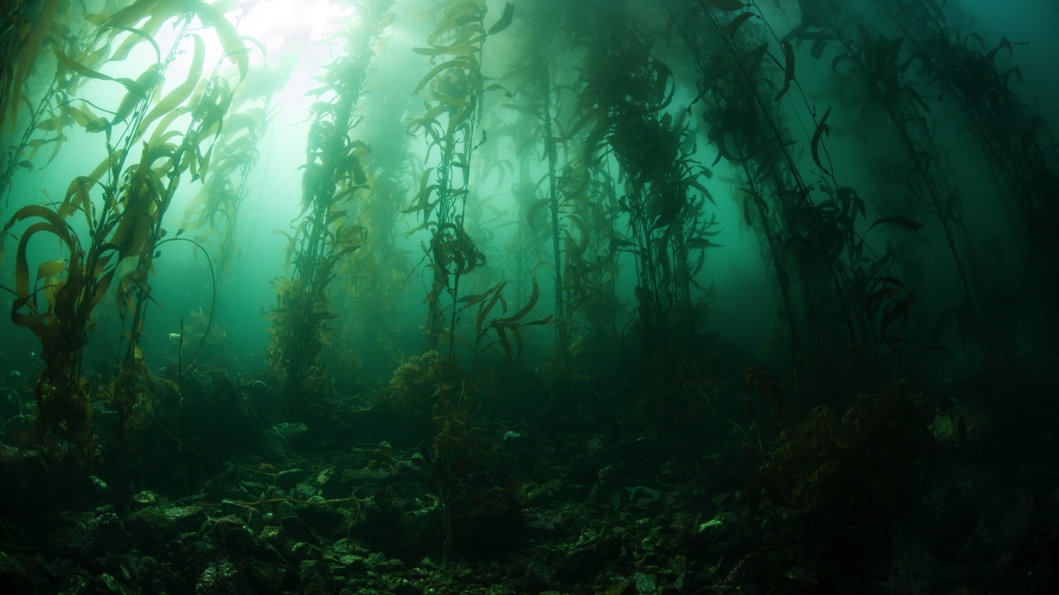
And finally…
“Social Media is both an art and a science”
Learn content that gets community talking
Set and budget time allocated
Build sustainable strategy for long-term game
Be true, human, honest, relevant and true to our mission.. And have fun with it!

Slide 18

Thank you!
Melissa Mefford
mmefford@surfrider.org

